Slide 1


Subject Name :MOBILE COMPUTING Presentation Title :WIRELESS TELEPHONY APPLICATIONS
JEPPIAAR INSTITUTE OF TECHNOLOGY
“Self-Belief | Self Discipline | Self Respect”
Department of Computer Science and Engineering
Team Members:
Students Name Reg.No:
1. SHANU S 210617104048
2.KARTHIKA R 210617104026
3.BOUNA DAS Y 210617104012
4.THENMOZHI R 210617104054
5.ABINAYA P 210617104002
6.MYTHILY B 210617104034

Slide 2
Introduction
WTA is a collection of telephony specific extensions for call and feature control mechanisms, merging data networks and voice networks.
It is an Extension of basic WAE application model with following features
network model for interaction
event handling
telephony functions

Slide 3
WTAI (Wireless Telephony Application Interface) include
Call control
Network text messaging
Phone book interface
Event processing
Security model: segregation
Separate WTA browser
Separate WTA port

Slide 4
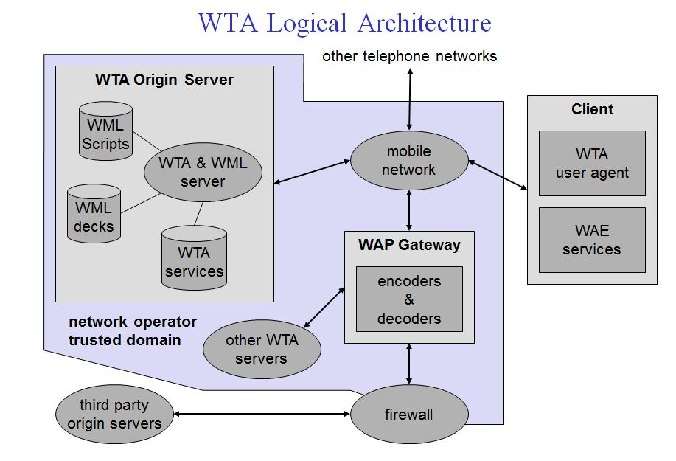
WTA logical architecture

Slide 5
The client is connected via a mobile network with a WTA server, other telephone networks and a WAP gateway.
A WML user agent running on the client is not shown here.

Slide 6
The client may have voice and data connections over the network.
Other origin servers can be connected via the WAP gateway.

Slide 7
IMPLEMENTATION
The key idea of the above algorithm is that, for EVERY channel/process intersection, EXACTLY one marker must pass.
So, if a process starts the algorithm, it sends a Marker on each outgoing channel and then records messages on each incoming channel until a Marker appears on it.
Once a marker has arrived on each incoming channel, that process is finished recording its part of the snapshot.

Slide 8
CHANDY AND LAMPORT
Chandy and Lamport were the first to propose a
algorithm to capture consistent global state of a distributed system.

Slide 9
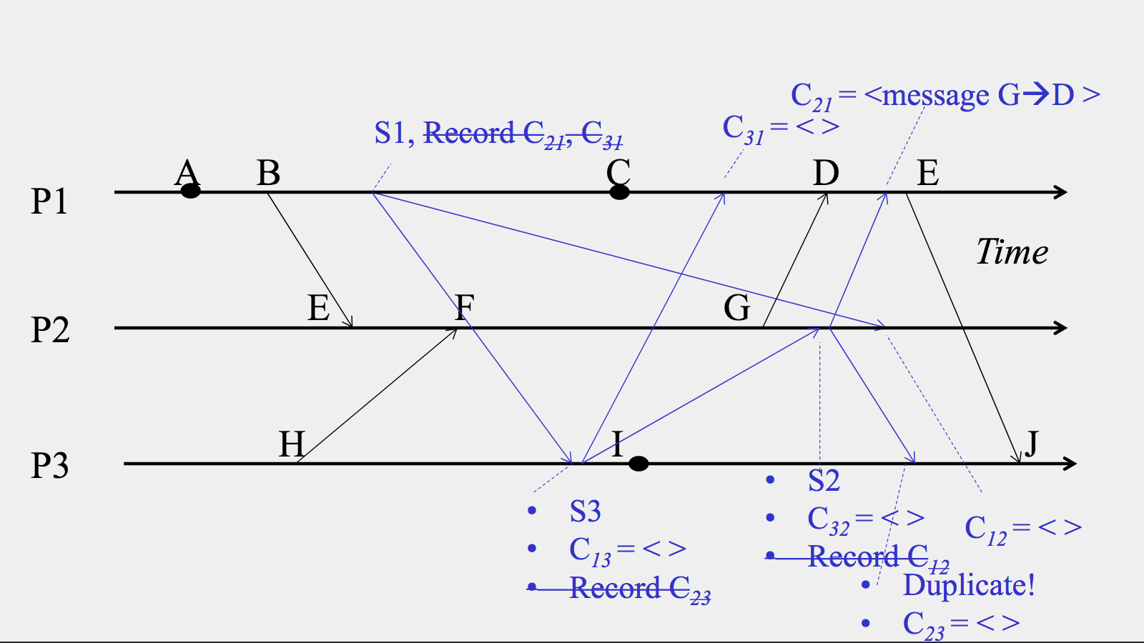

Slide 10
Result & Discussion
It concentrates more on
network model for interaction
event handling
telephony functions

Slide 11
Future Scope
The main idea behind proposed algorithm is that if we know that all message that hat have been sent by one process have been received by another then we can record the global state of the system.

Slide 12
REFERENCE:
https://professormerwyn.wordpress.com/2015/04/24/wireless-telephony-application-wta/

